Slide 1
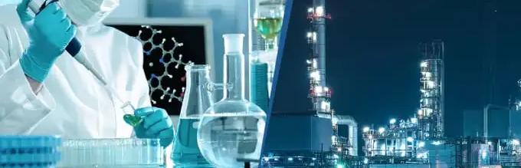
Industrial Chemistry
Biodiesel

Slide 2

Overview
Review of fatty acids and triglycerides
Biodiesel
Base catalysed transesterification method
Lipase catalysed transesterification method
Multi-sequence synthesis of ethyl ethanoate

Slide 3
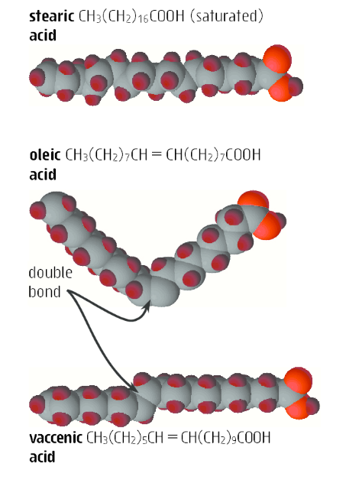
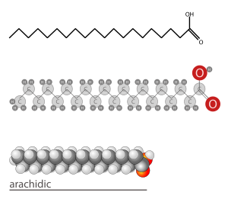
Review of fats, oils and fatty acids
Fatty acid – a long hydrocarbon chain ending in a carboxylic acid functional group. They can be saturated (all single C-C bonds), cis-unsaturated (contain C=C bond with cis geometry, or trans-unsaturated (contain C=C bonds with trans geometry)

Slide 4
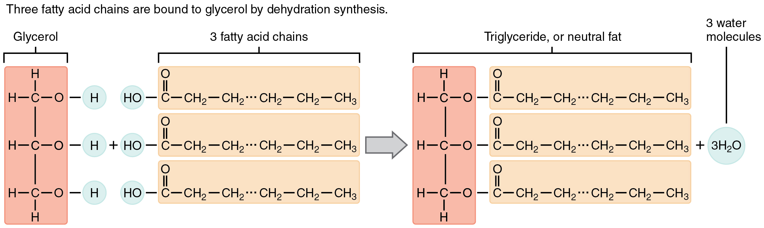
Review of fats, oils and fatty acids
Fats and oils – triglycerides formed from an esterification reaction between glycerol (1,2,3-propantriol) and three fatty acid molecules

Slide 5
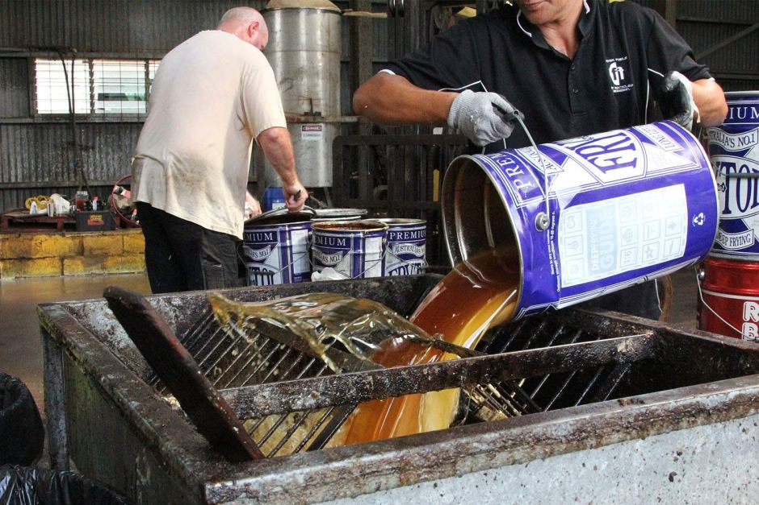
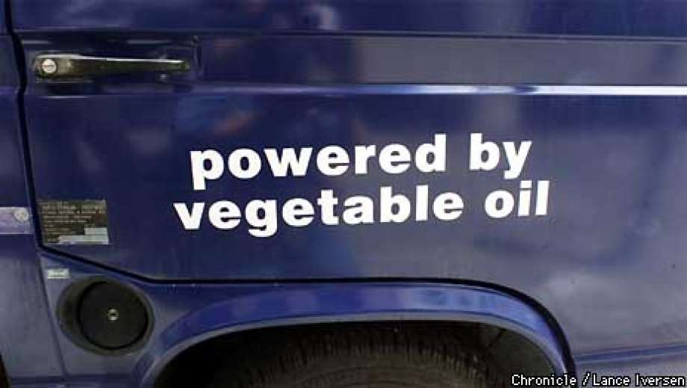
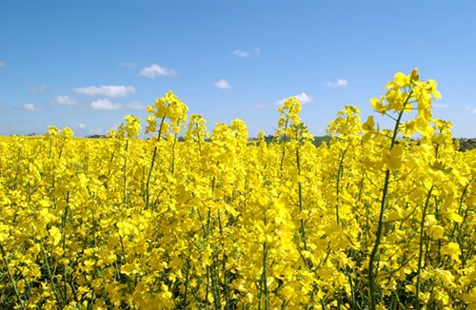
Biodiesel
Uses natural fats and oils eg canola oil, soybean oil, palm oil, animal tallow/fat, used cooking oils.
Produces a liquid consisting of methyl or ethyl esters of naturally occurring fatty acids
Almost entirely produced by base catalysed trans-esterification of triglycerides
Is often blended with fossil fuel diesel eg B10, B20 or B100

Slide 6
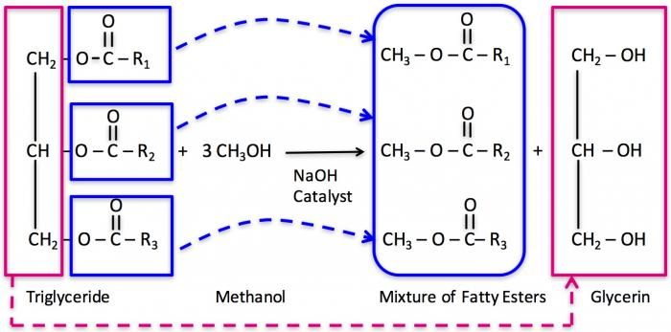
Biodiesel

Slide 7
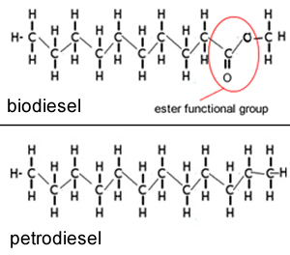
Base catalysed transesterification of triglycerides
What is biodiesel?
Biodiesel is a methyl or ethyl ester of a fatty acid. Look at the picture – long hydrocarbon chain to an ester link to a methyl group (it can also be an ethyl group)
Compare this to petrodiesel (from crude oil) – it contains no oxygen in the structure.

Slide 8
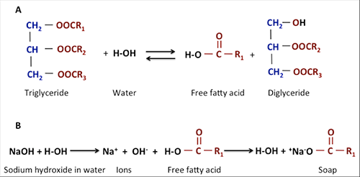
Base catalysed transesterification of triglycerides
Step 1: Chosen feedstock is filtered to remove foreign matter and treated to remove water (water results in undesirable side reaction involving conversion of esters into soap)
Unwanted side reaction:

Slide 9
Base catalysed transesterification of triglycerides
Step 2: once filtered and dried, the material is analysed to determine how much free fatty acid is present (mixed in with the triglyceride)
If free fatty acid (FFA) content exceeds 4% then oil is treated to reduce FFA content (or soap formed instead of ester)
One method is to treat FFA’ s with methanol and an acid catalyst prior to transesterification
Converts FFA’S to FAME fatty acid methyl ester (biodiesel)

Slide 10
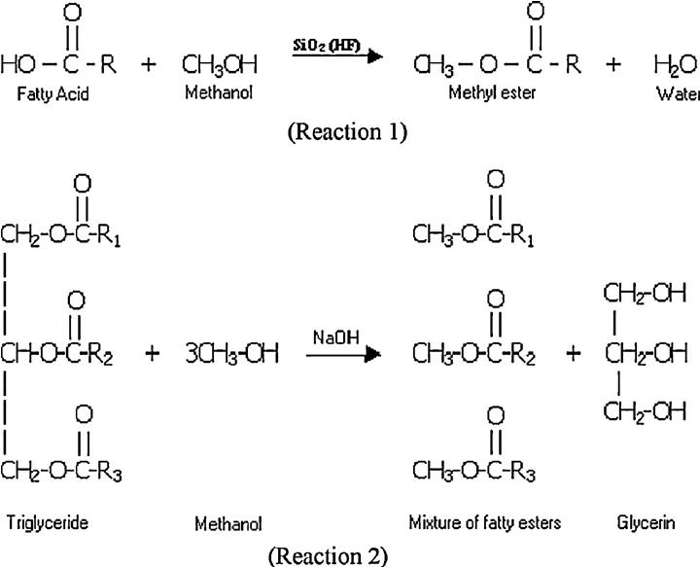
Base catalysed transesterification of triglycerides
Step 2: remove the FFA using an acid catalysed esterification reaction with the FFA and methanol. This converts the FFA into the desired fatty acid methyl ester (aka biodiesel)
H₂SO₄
⇄

Slide 11
Base catalysed transesterification of triglycerides
Step 3: Convert the remaining triglycerides into fatty acid methyl esters (biodiesel) using a transesterification (trans – meaning switch, so you switch on ester group for another ester group)

Slide 12
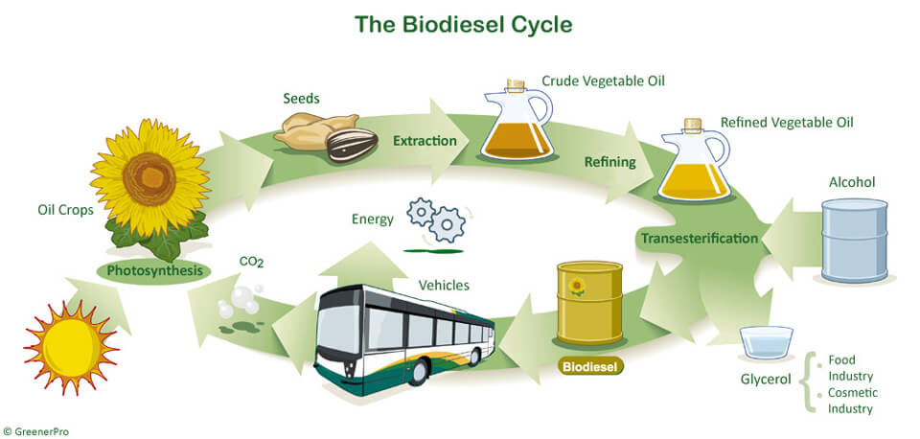
Base catalysed transesterification of triglycerides
After suitable preparation the oil then undergoes transesterification to produce biodiesel
Very slow equilibrium process so a catalyst is used to achieve reasonable rate
Most biodiesels use a strong base (NaOH or KOH) to catalyse
Further increase speed moderate temp 60°C
Typically methanol or ethanol are mixed with base to prevent loss of volatile alcohol

Slide 13
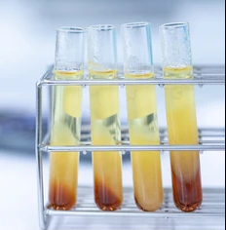
Base catalysed transesterification of triglycerides
The required stoichiometric ratio is 3:1 but alcohol is added in large excess 6:1 as higher concentration favours high yield (98%)
Biodiesel and glycerol are insoluble in one another so separation is easy
Biodiesel is washed with warm water to remove any residual catalyst, methanol or soap, then dried
Glycerol layer is also treated for further use

Slide 14
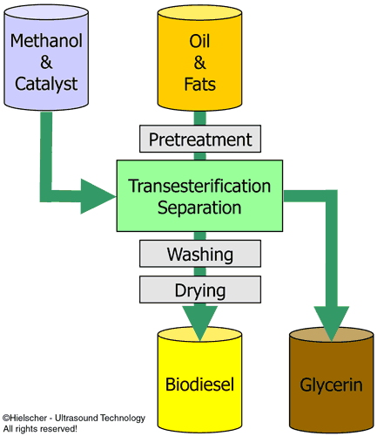
Base catalysed transesterification of triglycerides

Slide 15
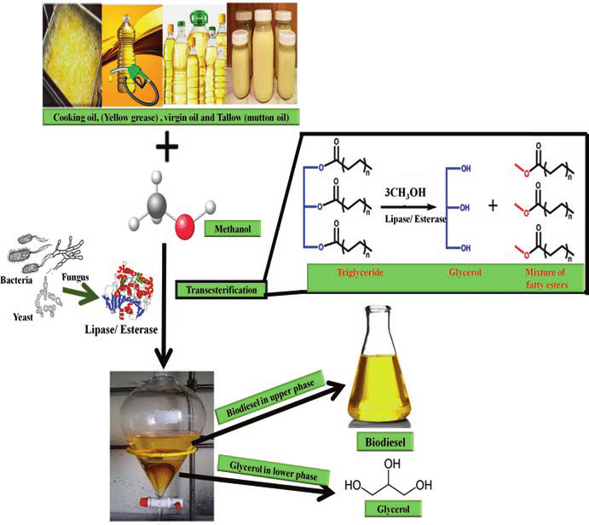
Lipase catalysed transesterification of triglycerides
Greener method – still experimental/developing
Replaces strong base with enzymes known as lipases (naturally occurring enzyme found in cellular materials of living things)

Slide 16
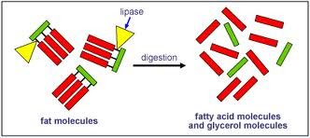
Lipase catalysed transesterification of triglycerides
Advantages :
Milder temperatures and pH
No need to treat FFA’s
Do not cause side reactions (soap formation)
Simplify product purification
Use less energy (lower temp) to produce
Disadvantages
Slower acting (higher catalyst concentration required)
Lipase catalysts quite expensive
Lipase recovery from final process is difficult

Slide 17

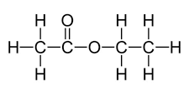
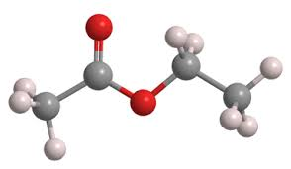
Manufacture of ethyl ethanoate
Ethyl ethanoate is an ester, that is a liquid at room temperature and has a fruity odour.
Occurs naturally in fruit (bananas and pineapples)
Industry it is used as a solvent and is favoured due to its low toxicity. (nail polish remover)

Slide 18
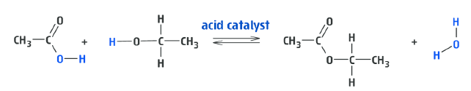
Manufacture of ethyl ethanoate
It is synthesised by the Fischer esterfication reaction of ethanol and ethanoic acid in the presence of an acid catalyst.
The process is reversible with the yield at 298 K being ~ 65% and the reaction mixture being homogeneous.
Ethanoic acid costs more, so they use an excess of the cheaper ethanol to maximise the conversions of the ethanoic acid into product
By continually removing the product the yield can as high as 95 %

Slide 19
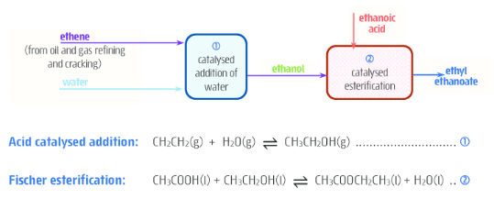
Manufacture of ethyl ethanoate
The synthesis of ethyl ethanoate is often done as part of a reaction sequence involving the conversion of ethene into ethanol and then the ethanol into ethyl ethanoate.

